Slide 1

Power Grid Stability Assessment
Problem type: Classification

Slide 2

With the advent of renewable options, end users (households and enterprises) now not only consume energy but have the ability to produce and supply it - hence a new term to designate them, 'prosumers'. As a result, energy flow within distribution grids - 'smart grids' - has become bidirectional
the management of supply and demand in a more complex generation / distribution / consumption environment and the related economic implications (particularly the decision to buy energy at a given price or not) have become even more challenging.
Mathematically possible to calculate stability but the execution of mathematical model relies on significant simplifications and real time reliability is low
Such inconsistency leads to slow demand response, generator trips etc hence incurs significant losses.
Problem Statement
Assess Grid Stability in Real Time
Diagnose if grid is unstable
Set recommendation if unstable

Slide 3
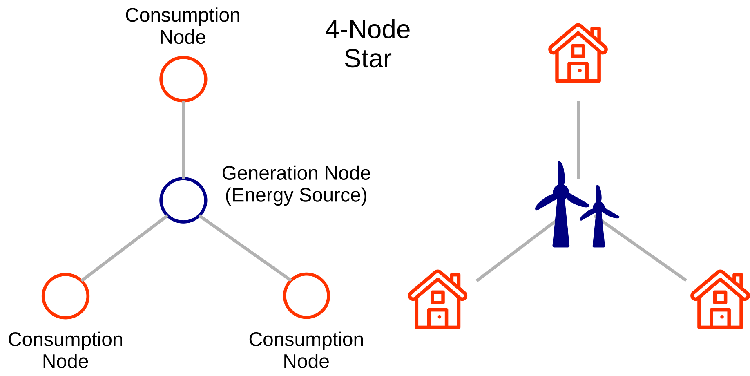
MIST’s target is to forecast solar generation data for grid efficiency
Identified the data required to address Target: Do Critical thinking on Target:
Target
Classify Grid Stability
Power Demand
Power Supply
Grid Responses
Weather
Behavior pattern
Generation from each sources
Gas Plant
Renewable Sources
Hydro
Price Elasticity
Reaction time
Producer
Consumer
Power Balance
Producer
Consumer

Slide 4
Grid Parameters History Data.
'tau1' to 'tau4': the reaction time of each network participant, a real value within the range 0.5 to 10 ('tau1' corresponds to the supplier node, 'tau2' to 'tau4' to the consumer nodes);
'p1' to 'p4': nominal power produced (positive) or consumed (negative) by each network participant, a real value within the range -2.0 to -0.5 for consumers ('p2' to 'p4'). As the total power consumed equals the total power generated, p1 (supplier node) = - (p2 + p3 + p4);
'g1' to 'g4': price elasticity coefficient for each network participant, a real value within the range 0.05 to 1.00 ('g1' corresponds to the supplier node, 'g2' to 'g4' to the consumer nodes; 'g' stands for 'gamma');

Slide 5

So lets Run with a Robot AI…..

Slide 6
Get the Decision with 4 Steps
Login
Create a solution under Energy, Solution Name “Grid Stability”→ solution type: Classification→ Click create solution
Build Model
Data
Select Variables
Uncheck variable day, month, year, week, season
Select Algorithm
Click on Train
Click on Finalize
You will land on Deploy page
Upload smart_grid_stability_train.csv data
A variable list will show up→ click on skip
Select target. Choose “stabf” as your target
A window will pop up asking you run the preliminary analysis or not. Press Yes Button
Preliminary analysis will run-→see result in Confusion matrix chart and Prediction KPI for error
Press Next→ land in “build Model page

Slide 7
Get the decision with 4 steps
Deploy
Decision
Click on Add data→
upload new data, from CSV source from you grid_stability_pred.csv file
A variable list will show up→ click on skip
Go to Data Post Process
Create 3 equation by clicking on create custom variable
Action:
If stabf = unstable , Freq change % = abs(tau1-g1)/(tau1+g1)*100
If stabf = unstable , Volt Change % = abs(tau1-g1)/(tau1+g1)*100
Go to Result Configuration
Check download as CSV
Select Algorithm
Press “Predict”, prediction will be running
Press Next→ you will land in Decision Page
Select Decision Scenario Tab
Change slider value for different variables
Press Apply
Do the step until Target or Target desired value is higher or lower or middle

Slide 8


